Slide 1


Cabria Lee | Dr. Parenteau | St. Thomas University

Slide 2
Problem Overview
Statement of the problem
Data Source
Description
Data analysis and models
Conclusion

Slide 3
Statement of the problem
Do college basketball teams win more games based on adjusted offensive efficiency or defensive efficiency, based on past data and statistics?

Slide 4
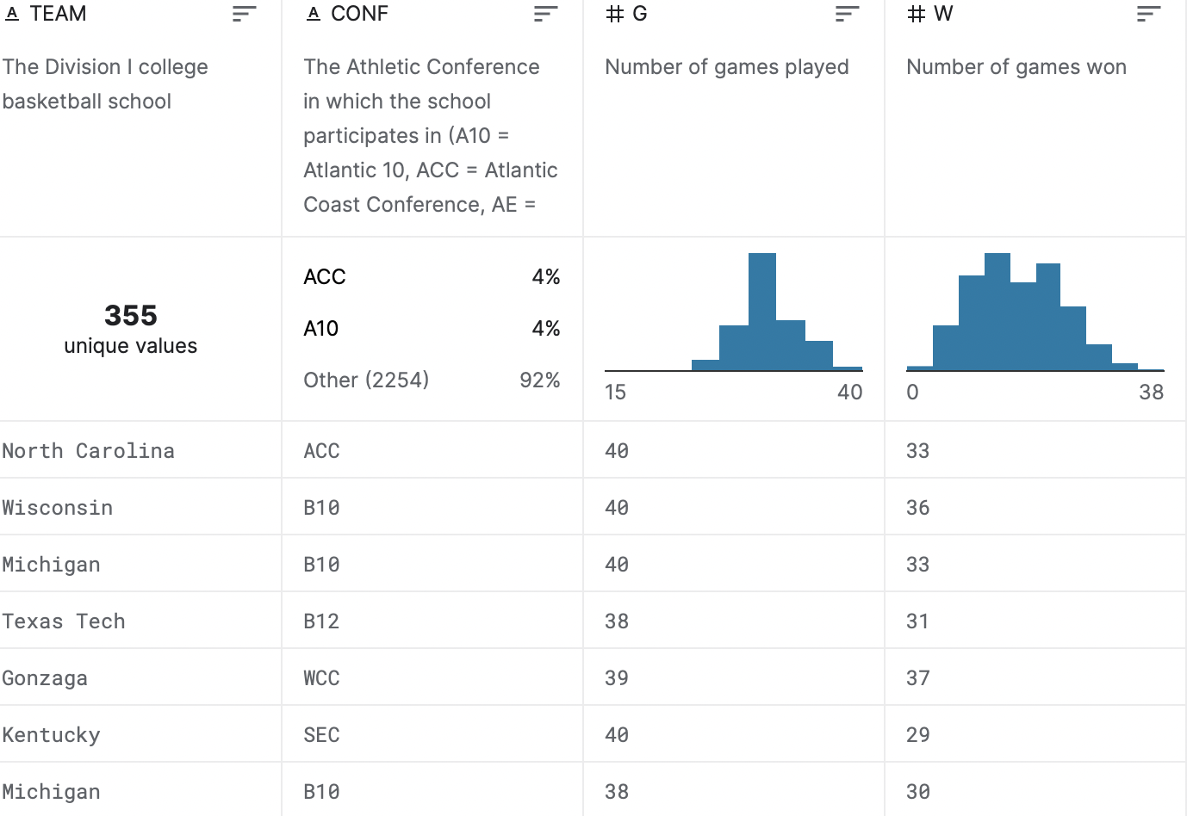
Data Source
The data source is from Kaggle. It shows data from 2013-2021.

Slide 5
Description
The NCAA makes predictions each year on which team is favored to win the March Madness. These predictions are based on stats correlating to the most wins and points scored. There’s a saying that defense wins championships. Based on data, you can conclude that defensive efficiency matters more than offensive efficiency. So, these teams have more successful seasons.
I analyzed data from the 2013-2021 division I college basketball seasons.

Slide 6
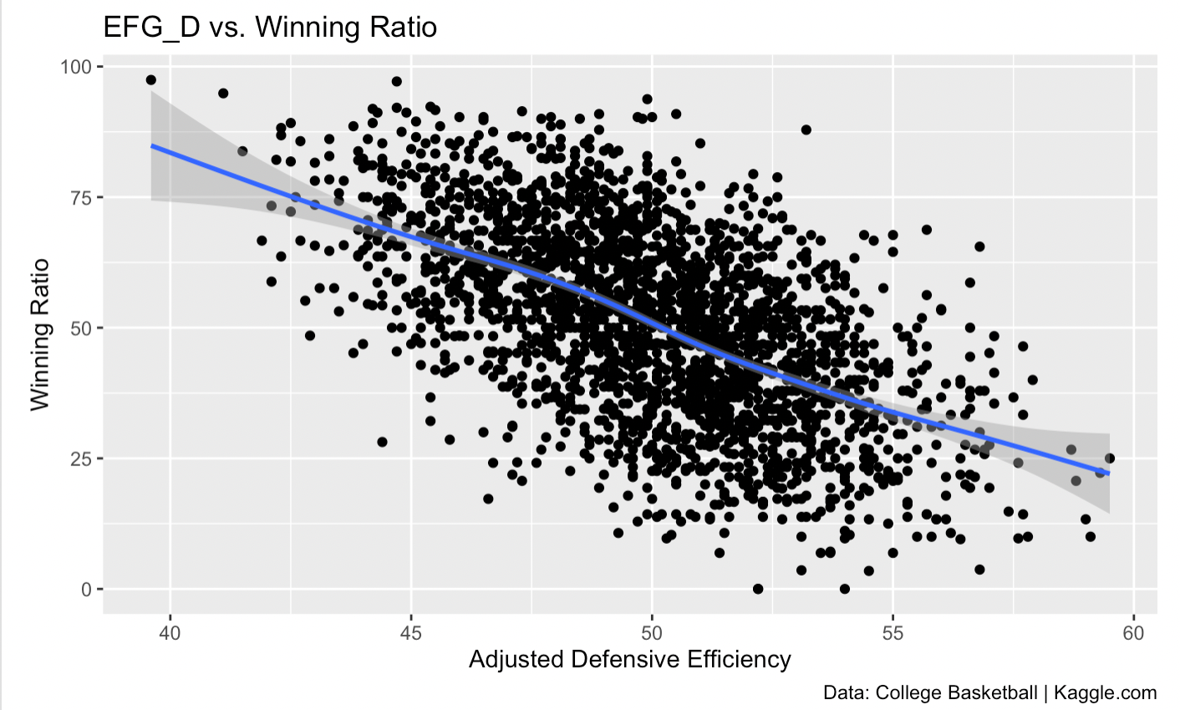
Data Analysis
The winning ratio is higher when the adjusted defensive efficiency is lower.
09.05.XX

Slide 7
Conclusion
Based off data, adjusted offensive efficiency correlates to more winning seasons in college basketball. The relatively narrowed scope of college basketball allows for a straightforward analysis of team efficiencies.

